Slide 1
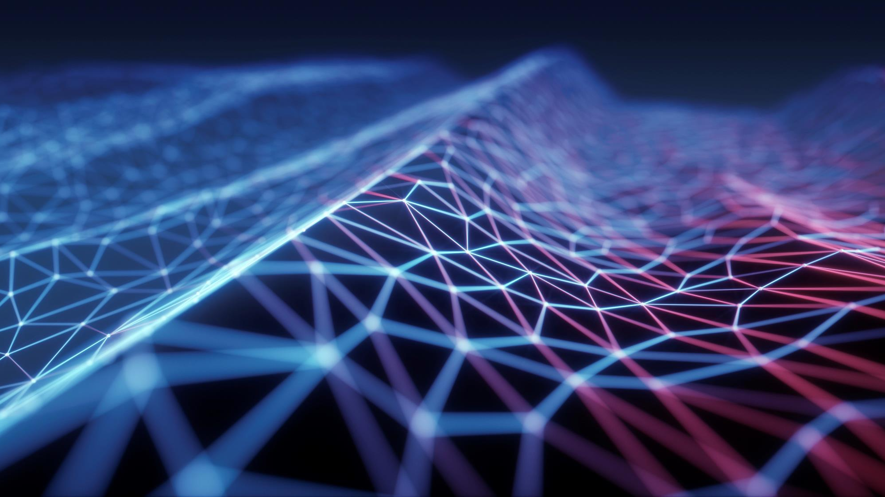
CYBERTHON.AI - 2025
CHANDIGARH POLICE (IN PARTNERSHIP WITH INFOSYS, CHANDIGARH)

Slide 2

CONTENTS
Team Details
Problem Statement – Description / theme selected
Solution Proposed
Expected Benefits to Policing
Technical Design / Architectural Diagram
Solution - Screenshots
Assumptions

Slide 3
TEAM DETAILS
Team Name : Data Rangers
Team Members-
Hitesh - hiteshrao7704@gmail.com
Harsh Raj - harshrajthakur1207@gmail.com
Aditi Raj
Anwesha Choudhary
Team Leader: Hitesh
Topic Selected for Solution: Intelligent Financial Fraud Detection using UPI and VoIP Data (Cybercrime)
Category : Student

Slide 4
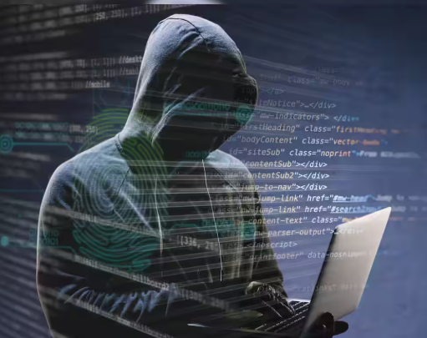
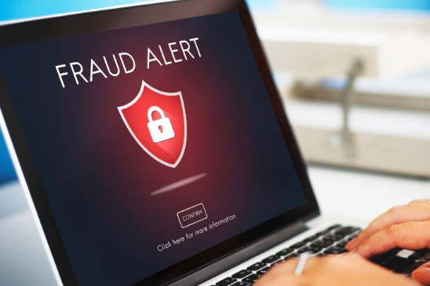
PROBLEM STATEMENT – CYBERCRIME
Intelligent Financial Fraud Detection using UPI and VoIP Data: To Develop a smart system that uses machine learning to detect and alert about fraudulent UPI transactions, scam VoIP calls (including spoofed numbers), and suspicious payment patterns.
Financial fraud via UPI & VoIP is rising.
Difficult to detect real-time spoofed calls, fake UPI txns
Law enforcement lacks integrated early-warning systems
Challenge: Develop a fraud scoring + real-time alert engine

Slide 5
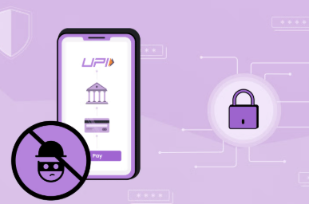
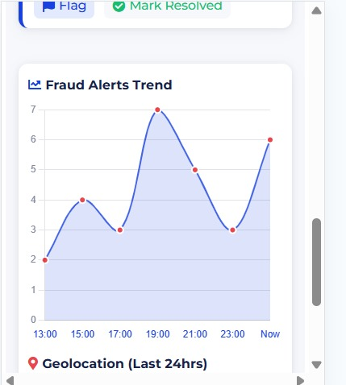
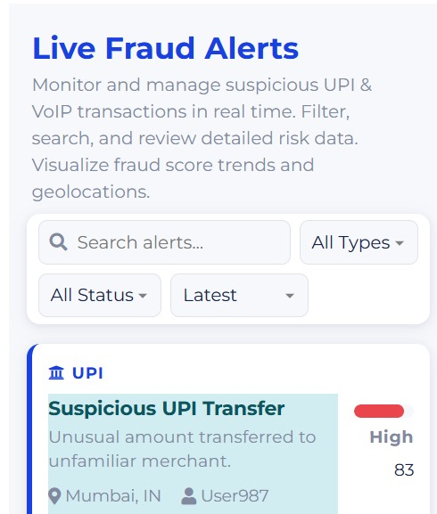
SOLUTION PROPOSED
Simulated dataset for UPI/VoIP
ML-based fraud scoring engine (LightGBM)
Real-time alert dashboard (Streamlit prototype)
Fraud classification, geolocation, spoof detection, threshold-based alerts

Slide 6
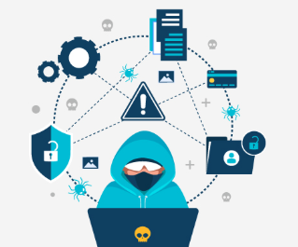
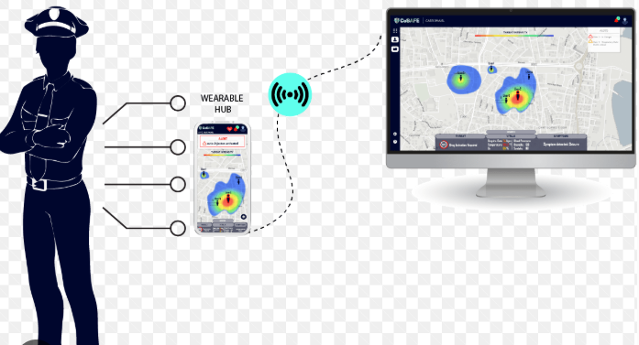
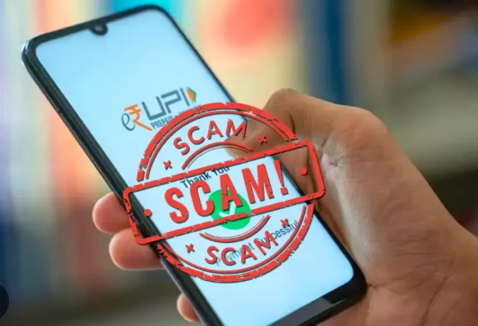
EXPECTED BENEFITS TO POLICING
Early fraud detection from UPI and scam calls
Helps identify fraud networks through pattern linking
Alert system for field response in real-time
Scalable to include banking fraud, mobile app data

Slide 7

TECHNICAL DESIGN / ARCHITECTURAL DIAGRAM
Data Simulation
Preprocessing
ML Models (UPI/VOIP)
Fraud Scoring Engine
Alert Dashboard
TECH REQUIREMENTS:
Python, Flask, Typescript , Java-script
Machine Learning / Artificial Intelligence (AI)
Data Science
Application Programming Interface (API)
UI/UX ( For Interactive Dashboard)
Integration tools

Slide 8
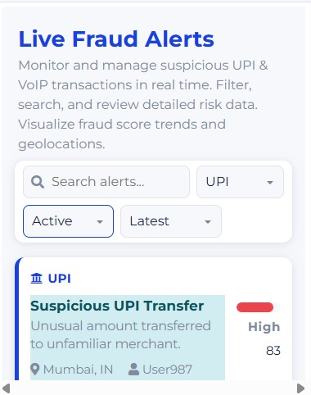
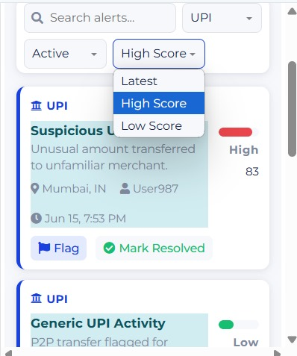
SOLUTION - SCREENSHOTS

Slide 9
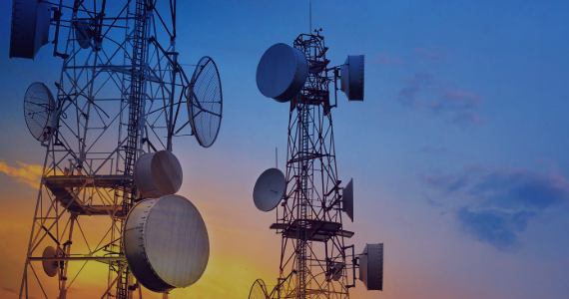

ASSUMPTIONS
No access to real VoIP/UPI datasets — simulated data used
Alert threshold (0.7) empirically chosen
Model trained using synthetic but realistic data
Integration with real UPI/telecom systems is a future goal

Slide 10



APPENDIX Prototype Link (Prepared Till Now) :- https://github.com/HITESHRAO2004/Intellingent-Financial-Fraud-Detection-using-UPI-and-VOIP-data.git
Network
Satellite
Link

Slide 11
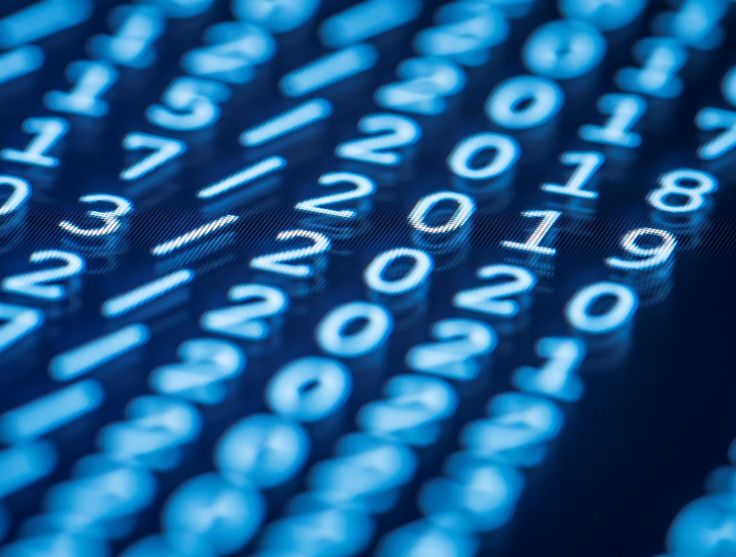
THANK YOU
TEAM : DATA RANGERS

